Slide 1
Socioeconomic Classifier based on Ballot Box (Kalpi) Results
A project in data science and data analysis
November 2023

Slide 2
Overview
This project applies machine learning techniques to a key topic in Israeli socio-politics: The relationship between socioeconomic status and Knesset voting patterns. It predicts a neighborhood’s socioeconomic index (SEI) based on its kalpi results.
The presentation covers the following:
Data collection and tagging.
Exploratory statistics: trends, intricacies, exceptions.
Considerations towards ML classification: approaches, features, optimization.
Classifier evaluation: results, challenges, solutions and insights.
Combining classifiers and future work.

Slide 3
Understanding the problem
Socioeconomics and voting in Knesset elections
Israeli voting patterns are largely sectarian:
Jews: secular / traditional / religious / ultra-orthodox / immigrants.
Arabs: Palestinian (urban/rural, Muslim/Christian) / Bedouin / Druze-Circassians-Alawites.
Different sectors are quite stratified socioeconomically:
Jews: secular > religious > immigrants > traditional > ultra-orthodox
Arabs: Christian > Druze etc. > urban Muslim > rural Muslim > Bedouin
Research question:
Are these coarse country-wide generalizations manifested in fine numerical patterns?
Can the ballots in a given kalpi indicate the socioeconomic index of the neighborhood?

Slide 4
Socioeconomic data (from the Central Bureau of Statistics):
Most recent (2019) socioeconomic index (SEI): 1 - 10 ordinal scale
One SEI per ‘socioeconomic zone’:
Individual small rural locality (~1000 rural zones).
E.g. Bat Shlomo - 8; Amirim - 6; Rumat Heib - 2.
Neighborhood-size section of urban locality (~2000 urban zones)
E.g. Holon 312 ‘Rasko G’ (major streets: Yerushalaim, HaShita, …) - 7; Rehovot 121 ‘No name’ (major streets: HaShomrim, Sireni, …) - 5.
No direct mapping from address to SE zone.
For Arab localities (except Nazareth, Rahat): no internal zone indices provided.

Slide 5
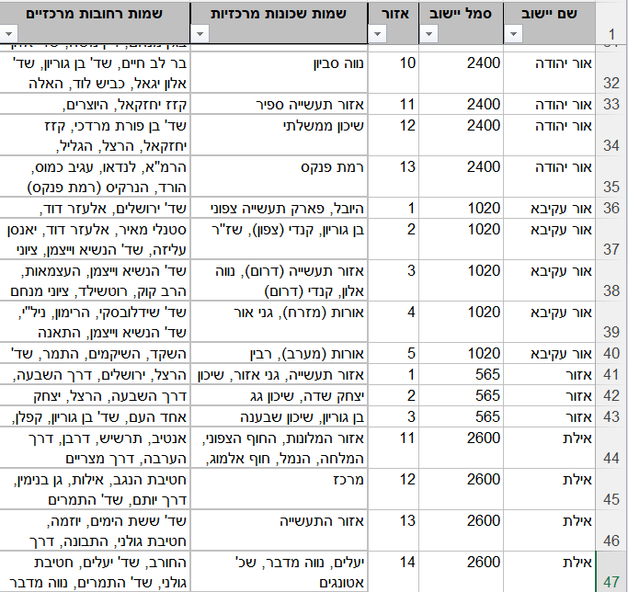
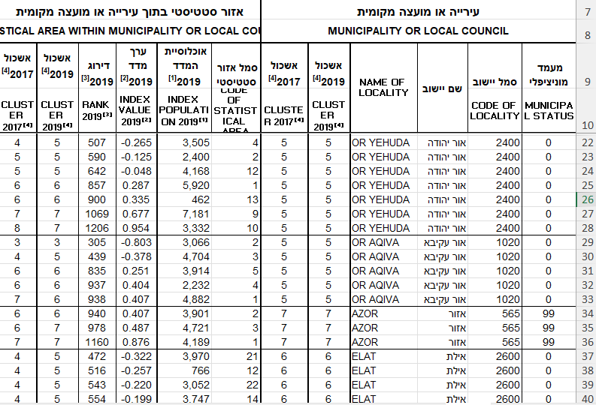
Socioeconomic data
Original CBS Excel sheets
Zoning: SE-indexing:

Slide 6
Voting data (from the Central Election Committee):
Ballot box (kalpi) data from the 25th Knesset elections (1 Nov. 2022)
~11700 kalpiot (+ ~800 double-envelope ‘mobile’ kalpiot), each with:
Identification info, including ID and street address / public building, e.g.:
kalpi 1755, Daburiyye, 7 AlYasmin st., Family Health Center
kalpi 6717, Gan Yavneh, Meiron st., Maccabim Primary School.
Numeric voting data:
General: eligible voters - actual voters - legal votes. E.g. 662 - 475 - 471
Ballot: voters per list, e.g. אמת 13, ב 5, ג 2, ד 0, ום 0, ט 52, כן 83, ל 14, מחל 143…

Slide 7
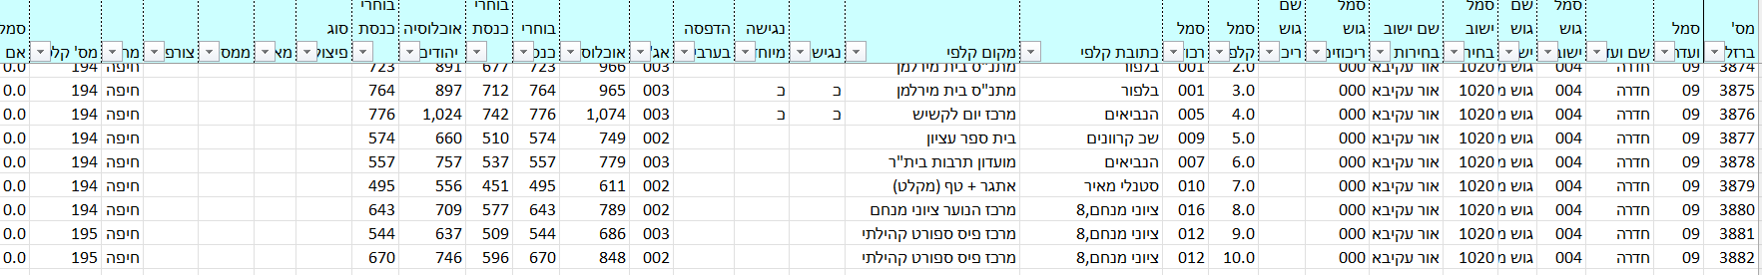
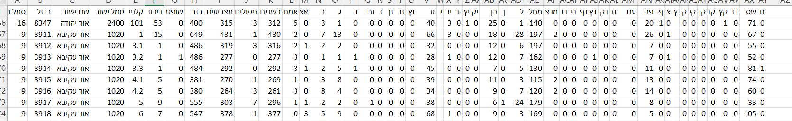
Knesset kalpi and voting data
Original CEC Excel sheets
Kalpi details:
Votes:

Slide 8
Data preparation and tagging:
Combining CBS and CEC data:
Matching locality zoning with per-zone index (from different CBS Excel sheets)
Matching kalpi street address with kalpi results (from different CEC Excel sheets)
Obtaining SEIs for ~20% of kalpiot (respectively from CBS and CEC data):
~1500 kalpiot in small rural localities:
Straightforward mapping of kalpi to SEI
Problem: overrepresentation of certain sectors (Jews, middle class).
~860 urban kalpiot from ~30 urban/larger localities to counter the imbalance.
Problem: extensive manual tagging, as obtaining urban SE zone from kalpi address requires manual search on a map.

Slide 9
Data preparation and tagging (cont.):
Towards meaningful kalpi data (still in Excel):
Excluded ‘double envelope’ kalpiot (they don’t represent residential areas).
Manually added available locality-based sector affinity, in the form of two binary ‘national’ variables - Jewish and Palestinian - as follows:
Converted absolute numbers to proportions (0<p<1):
Legal votes out of eligible voters.
Party list ballots out of legal votes: the 13 lists with >1% of the country-wide vote distribution, plus ‘others’.
Locality is … |  | Palestinian
 |  | yes | no
Jewish | yes | Mixed (Ramle): 891 kalpiot | Jewish (Eilat): 9165 kalpiot
 | no | Arab (Taibe): 1507 kalpiot | Druze/Circassians/Alwaites (Julis): 144 kalpiot

Slide 10
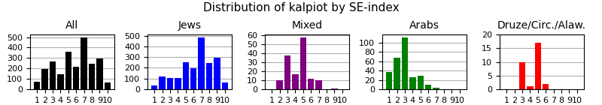
Exploratory statistics of the 2363 SEI-tagged kalpiot:
Analyses using Python (numpy, pandas, matplotlib):
SEI-tagged kalpiot by sector (percentage of kalpiot in sector): Jews: 1903 (21%) Mixed: 146 (16%) Arabs: 284 (19%) Druze etc.: 30 (21%)
Kalpiot distribution by SEI:
SEI | 1 | 2 | 3 | 4 | 5 | 6 | 7 | 8 | 9 | 10
kalpiot | 73 | 196 | 266 | 147 | 359 | 219 | 499 | 242 | 297 | 65

Slide 11
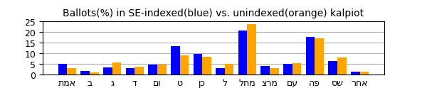
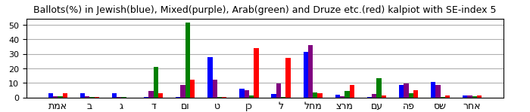
Exploratory statistics of the SEI-tagged kalpiot results:
Analyses using Python:
Slightly distorted vote distribution, i.e suboptimal sample, mostly due to SE biases:
Sector effect for kalpiot with the same SEI:

Slide 12
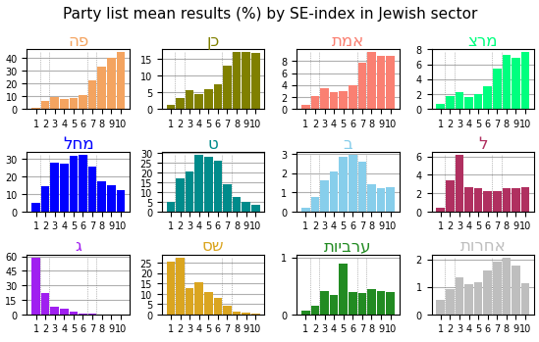
Exploratory statistics
Analyses of voting data in the Jewish sector
SEI | Trends
1 | Mainly Haredi with ג dominance. Little Right, Center-Left negligible.
2 | Dominance of שס as ג drops. Pronounced rise of Right. Rise of Ctr-Lf to low plateau. Emergence of ל to plateau.
3 | Rise of Right to dominance Drop of שס and ג. Local peak of ל.
4-6 | Right dominance. Gradual decline of שס as ג fades
7 | Mixed Rt - Ctr-Lf dominance. Decline of Right + שס. Steep rise of Center-Left.
8-10 | Center-Left dominance. Drop + decline of Rt, שס fading.

Slide 13
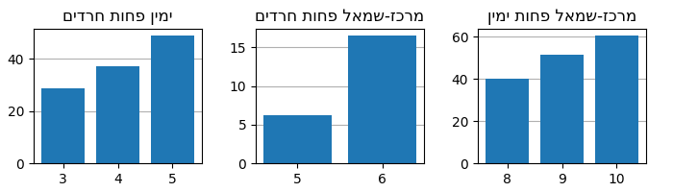
Exploratory statistics
Analyses of voting data in the Jewish sector (cont.)
Potential additional between-index distinctions for apparently similar SEIs SEI 3 vs. 4 vs. 5 SEI 5 vs. 6 SEI 8 vs. 9 vs. 10
Hopefully ML classifiers would identify such features.

Slide 14
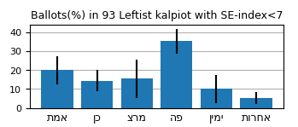
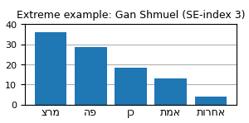
Exploratory statistics
Analyses of voting data in the Jewish sector (major exceptions)
Left-leaning exceptional trend:
93 of 806 kalpiot with SEIs 1-6 are Center-Left dominant (60%>, many 80%>)
56% of these are in cooperative kibbutzim (Gan Shmuel, Be’eri, Yotvata etc.)
Coop-economy thwarts CBS’s SEIs for otherwise SE-strong localities.
These kibbutzim are known and their kalpiot can be marked with a binary variable.
No opposite trend: only 14 of 604 kalpiot SEI-tagged 8-10 with 60%> Right-Haredi votes.

Slide 15
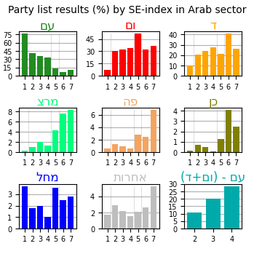
Exploratory statistics:
Analyses of voting data in the Arab sector:
SEI | Dominant sector | Trends
1 | Bedouin | Clear dominance of עם (religious). Limited presence of ום/ד (secular). Zionist parties combined: <8%
2-4 | Rural/Urban Muslim | Drop of עם and rise of ום/ד, to mixed three-party dominance. Then gradual rise of ום/ד at the expense of עם as SE-index (‘secular minus religious’ as potential internal cut-off). Zionist parties combined: still <8%
5 | Muslim-Christian | Further drop of עם. Dominance of ום. Rise of Zionist Parties: ~13%
6-7 | Christian | Mixed ום/ד dominance Further rise of Zionist Parties: >18% Too few kalpiot to generalize further.

Slide 16
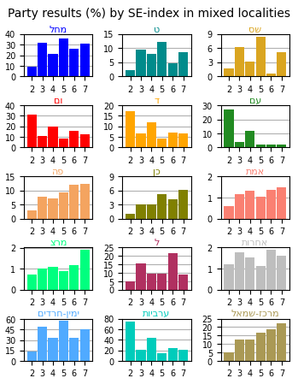
Exploratory statistics:
Analyses of voting data in mixed cities:
General trends:
Irregularities due to small sample: data from 3 out of 8 mixed cities, each with its own SE pattern of Jewish-Arab ‘mixture’. Block-specific rather than party-specific index-related trends: שס same as מחל/ט and עם same as ום/ד (cf. Jewish/Arab localities). Popularity of ל, further exaggerated by sample. Weak but consistently rising Center-Left correlated with SEI.
Ind. | Trends
2 | Dominance of Arab parties.
3 | Major Arab drop + Right rise (artifact?). Peak of ל as in Jewish locs.
4 | Right drop and Arab rise to mixed dominance, plausibly more representative than SEI 3 given general by-sector SE trends.
5 | Right rise to dominance as Arab parties drop to low plateau.
6 | Major ל peak (artifact?) as Right drops only to rise again in SEI 7.

Slide 17
From statistics to classifiers
General considerations
The data are characterized by clear trends:
Often with apparent cut-offs between adjacent SEIs.
Mostly manifesting known socio-political tendencies, e.g. vis a vis religion and nationalism.
These suggest a white-box approach, e.g. decision tree or logistic regression.
However…
Distributions in individual kalpiot are more diverse than the averages suggest (wide SDs).
Many local and complex discernable patterns are not apparent in averaged observation.
These suggest a black-box approach, e.g. random forest or neural network.

Slide 18
From statistics to classifiers
Features
Basic set - Only numerical features of the kalpiot (15 in total):
Proportion of valid ballots out of eligible voters.
Proportions of each of the party lists (>1%): מחל, פה, ט, כן, שס, ג, ל, עם, ום, אמת, מרצ, ד, ב
Proportion of all remaining party lists taken together
Extended set - Basic set plus 3 additional known per-locality binary features (18 in total):
is_Jewish: TRUE for Jewish and mixed localities, FALSE for Arab and Druze etc.
is_Palestinian: TRUE for Arab and mixed localities, FALSE for Jewish and Druze etc.
is_coop: TRUE for cooperative kibbutzim, FALSE elsewhere.

Slide 19
Socioeconomic classifiers
System pipeline
raw data
processed data
train data 80% test data 20%
data pre- processing
train-test split
classifier evaluation
hyper-parameter tuning
model
different classifier types
model
results
tuned classifier
classifier
results
#1
train data
test data

Slide 20
Socioeconomic classifiers
Classifiers and hyper-parameter tuning (sklearn, tensorflow, keras, Statsmodels)
Classifier type | Tuning framework | Hyper-parameters
Decision tree sklearn.tree.DecisionTreeClassifier | Exhaustive grid search* (sklearn.model_selection.GridSearchCV) | max_depth (4-11); min_samples_split (2,4,...,10); min_samples_leaf (1-5)
Ordinal logistic regression Statsmodels.miscmodels.ordinal_model.OrderedModel | Exhaustive loop-based search | distr (logit,probit); method (nm,bfgs,powell,cg,ncg,minimize)
C-Supported Vector Classification sklearn.svm.SVC | Exhaustive grid search* | C(0.1,0.3,1,3,10,30,100,300); kernel(linear, poly,rbf,sigmoid); break_ties(True/False)
Random forest sklearn.ensemble.RandomForestClassifier | Two-stage (coarse + fine**) random grid search* (50 trials each) (sklearn.model_selection.RandomizedSearchCV) | m_estimators (coarse: 100,200,..,1400); max_depth (4-8); min_samples_split (4-10); min_samples_leaf (2-5); bootstrap (T/F)
Neural network keras.models.Sequential | Two-stage grid search*: coarse rand- om (50 trials) + fine** exhaustive | learning_rate (coarse: 0.05,0.005,0.0005); layer_nodes (10,13,...,28 - two inner layers); batch_size (15,20,...,55)
* All grid searches used 5-fold cross-validation within the train data. **Fine grid searches are based on the best-scored coarse trial, using small increments around hyper-parameter values.

Slide 21
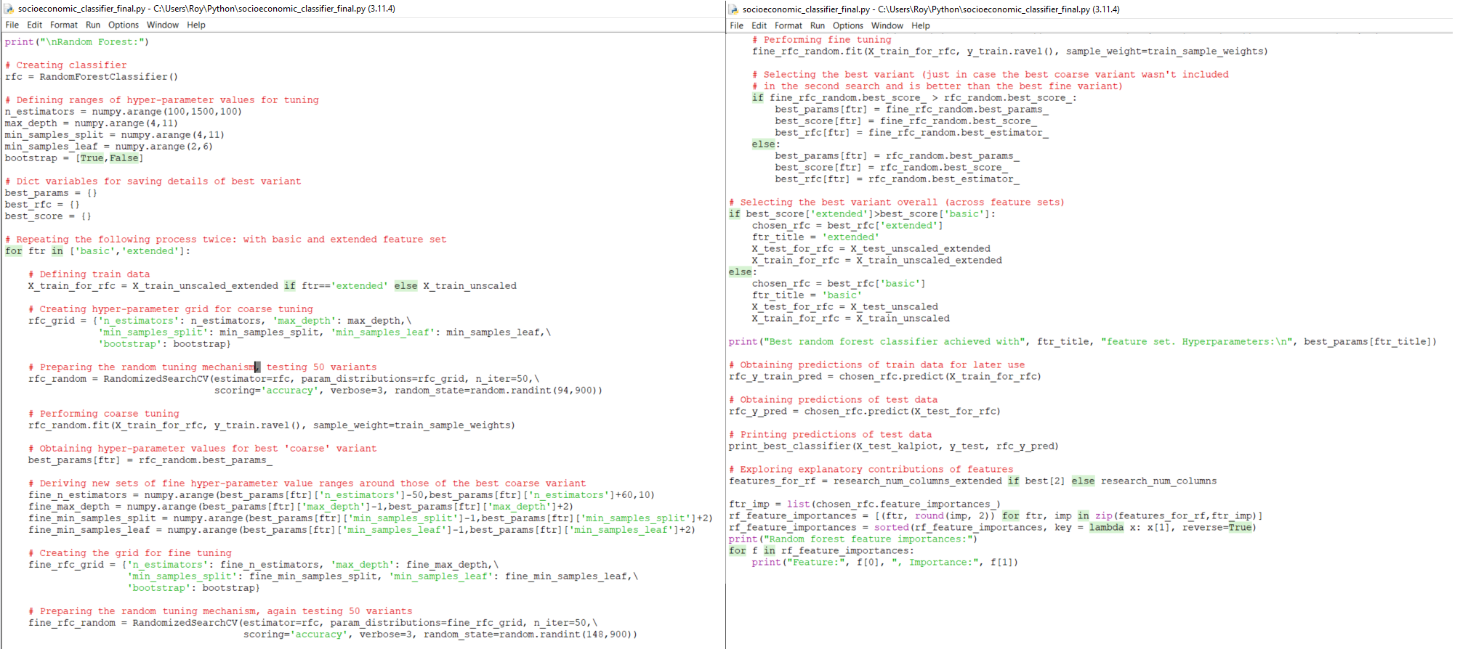
Socioeconomic classifiers
Hyper-parameter tuning for Random Forest - code sample

Slide 22
Socioeconomic classifiers
Classifiers and hyper-parameter tuning - additional details
Before eventual grid search, preliminary tuning for each classifier:
Certain hyper-parameters were discarded if values proved costly and ineffective (e.g. ‘entropy’ criterion in Decision tree and Random forest classifiers - used only ‘gini’).
Various score metrics were tried: accuracy, F1-score, macro F1-score, balanced accuracy. Accuracy was chosen (more on this later).
Each classifier was tried on the data using both ‘basic’ and ‘extended’ feature settings:
Best variant was found for each setting.
The best of the two was chosen to ‘represent’ the classifier.

Slide 23
Socioeconomic classifiers
NN-specifics (scikeras.wrappers, keras.losses/callbacks, sklearn.preprocessing)
Scaling: Proportions scaled to train-based z-scores (surprisingly outperformed min-max).
Wrapper: Sequential wrapped by KerasClassifier for compatibility with grid search:
variable input layer: basic vs. extended feature set.
variable number of neurons in internal layers.
Loss function: No standard for ordinal variables.*
Non-standard functions failed (e.g. coral_ordinal.OrdinalCrossEngropy).
SparseCategoricalCrossentropy was chosen as it substantially outperformed MSE, MAE.
Callbacks for optimal setting: Used ModelCheckpoint and EarlyStopping to save and later reload the setting with minimal validation loss.
* See e.g.: Lazaro, M. & Figueiral-Vidal, A. (2023), “Neural network for ordinal classification of imbalanced data by minimizing a Bayesian cost”, Pattern Recognition 137 Elbe, F. & Hall, M. (2001), “A Simple Approach to Ordinal Classification”. Lecture notes in Computer Science .

Slide 24
Classification results
First attempt - no sample weights
Promising results, compared to a ‘per-sector mode’ baseline accuracy of 0.252.
Feature importance (DT,RF): All features contribute. Also reflected in OLR coefficients.
But: strong distribution bias, poor recall for certain SE-indices.
Classifier (top settings) | Features | Acc. | Diff≤1 | Macro Recall | Recall per SEI
 |  |  |  |  | 1 | 2 | 3 | 4 | 5 | 6 | 7 | 8 | 9 | 10
DT (max_depth=9; min_samples_leaf=1; min_samples_split=2) | extended | .463 | .789 | .433 | .65 | .47 | .41 | .27 | .63 | .30 | .42 | .36 | .74 | .09
OLR (distr=probit; method=powell) | basic | .478 | .833 | .394 | .60 | .49 | .45 | 0 | .76 | 0 | .76 | 0 | .88 | 0
SVC (C=300; kernel=poly; break_ties=False) | extended | .514 | .839 | .458 | .80 | .36 | .53 | .29 | .57 | .26 | .78 | .15 | .84 | 0
RF (n_estimators=570; bootstrap=False; max_depth=9; min_samples_split=4; min_samples_leaf=2) | extended | .522 | .829 | .456 | .80 | .49 | .61 | .09 | .68 | .14 | .76 | .17 | .82 | 0
NN (layer_nodes=28; batch_size=20; learing_rate=0.01) | extended | .507 | .820 | .439 | .80 | .56 | .29 | .03 | .74 | .30 | .74 | .13 | .80 | 0

Slide 25
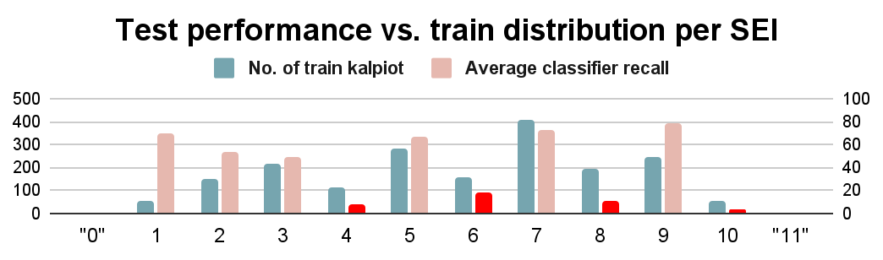
Classification results and analysis
Distribution bias across classifiers
 |  | 1 | 2 | 3 | 4 | 5 | 6 | 7 | 8 | 9 | 10
4 | DT OLR SVC RF NN | .03 .03 | .09 .06 .06 .09 .21 | .26 .24 .21 .15 .09 | .26 0 .29 .09 .03 | .24 .59 .32 .62 .62 | .06 .06 .03 | .06 .09 .03 .03 | .03 .03 | .03
6 | DT OLR SVC RF NN |  | .02 | .04 .02 .02 .04 .02 | .02 | .30 .42 .20 .34 .38 | .30 0 .26 .14 .30 | .30 .56 .52 .48 .30 | .02
8 | DT OLR SVC RF NN |  | .02 | .02 .02 |  | .04 .02 .06 | .04 | .27 .58 .40 .42 .50 | .36 0 .15 .17 .13 | .27 .42 .40 .40 .31 | .02
10 | DT OLR SVC RF NN |  |  |  |  |  |  |  | .09 | .82 1.0 1.0 1.0 1.0 | .09 0 0 0 0
SEIs 4,6,8,10 ‘linger’ samples to flanking attractor classes 3,5,7,9.
Not quantity problem per-se, e.g. SEI 1 vs. 8.
Rather, local ‘troughs’: Poor when quantity is less than average of flanking indices.

Slide 26
Classification attempt, Round #2
Classification results
Countering distribution bias
Counter-measures:
Selectively add data? The dataset already manifests this relative to earlier attempts.
Duplicate kalpiot for poorly-recalled indices? Risk of overfitting to specific kalpiot.
Change loss function? No standard function favoring balanced cross-class recall.
Add class-based sample weights? YES… but only if principled and not tweaked!
Weighting for samples of SEI i with n_{i} SEI-tagged kalpiot:
if n_{i} < ((n_{i-1}+n_{i+1})/2 , then: W_{i} = (n_{i-1} + n_{i+1}) / 2n_{i} , else: W_{i} = 1 (n₀ = n₁₁ = 0)
Yielding: W₁ = 1.34 W₄ = 2.13 W₆ = 1.96 W₈ = 1.64 W₁₀ = 2.28
Desired effect:
Boosted recall for SEIs 4,6,8,10 without Class 1 becoming attractor.
No significant degradation in total accuracy.

Slide 27
Classification results and analysis
Second attempt - with sample weights* **
Classifier (top settings) | Features | Acc. | Diff≤1 | Macro Recall | Recall per SEI
 |  |  |  |  | 1 | 2 | 3 | 4 | 5 | 6 | 7 | 8 | 9 | 10
DT (max_depth=10; min_samples_leaf=1; min_samples_split=4) | extended | .438 .463 | .763 .789 | .425 .433 | .75 .65 | .40 .47 | .43 .41 | .21 .27 | .45 .63 | .38 .30 | .43 .42 | .38 .35 | .66 .74 | .27 .09
SVC (C=300; kernel=poly; break_ties=False) | extended | .512 .514 | .846 .839 | .528 .458 | .80 .80 | .33 .36 | .43 .53 | .50 .29 | .45 .57 | .56 .26 | .58 .78 | .46 .15 | .62 .84 | .55 0
RF (n_estimators=1310; bootstrap=False; max_depth=9; min_samples_split=4; min_samples_leaf=1) | extended | .505 .522 | .846 .829 | .476 .456 | .80 .80 | .36 .49 | .61 .61 | .29 .09 | .49 .68 | .54 .14 | .60 .76 | .42 .17 | .56 .82 | .09 0
NN (layer_nodes=28; batch_size=55; learing_rate=0.001) | extended | .516 .507 | .854 .820 | .494 .439 | .75 .80 | .31 .56 | .49 .29 | .29 .03 | .54 .74 | .50 .30 | .59 .74 | .54 .13 | .66 .80 | .27 0
* Results of the first attempt are repeated in small fonts. ** The OLR model is experimental and has no sample weight option.

Slide 28
Classification results and analysis
Accuracy and recall
Decision tree - overall degradation (weakest to begin with).
Support vector machine - overall improvement:
No degradation in accuracy.
Model with most balanced recall - greatest improvements and least degradations.
Random forest - expected (and welcome) tradeoff:
Slightly degraded accuracy (but improved near-accuracy).
More balanced recall per SEI.
Neural network - overall improvement:
No degradation in accuracy (and improved near-accuracy).
Much more balanced recall per SEI.

Slide 29
Classification results and analysis
Confusion matrices for best models (SVC and NN)
No major lingerers/attractors (except Class 9 for SEI 10 in NN).
SVC | 1 | 2 | 3 | 4 | 5 | 6 | 7 | 8 | 9 | 10
1 | .80 |  | .05 | .15
2 | .16 | .33 | .27 | .16 | .02 | .02 |  | .02 | .02
3 |  | .12 | .43 | .20 | .18 | .02 | .02 |  | .02
4 |  | .03 | .15 | .50 | .18 | .09 |  | .06
5 |  | .03 | .09 | .05 | .45 | .24 | .11 | .04
6 |  |  | .02 |  | .04 | .56 | .36 | .02
7 |  |  |  | .01 | .07 | .11 | .58 | .21 | .02
8 |  |  | .02 |  | .02 |  | .21 | .46 | .21 | .08
9 |  |  |  |  |  |  | .06 | .20 | .62 | .12
10 |  |  |  |  |  |  |  |  | .46 | .55
NN | 1 | 2 | 3 | 4 | 5 | 6 | 7 | 8 | 9 | 10
1 | .75 | .15 | .10
2 | .20 | .31 | .24 | .18 |  | .02 | .02 | .02
3 |  | .16 | .49 | .14 | .14 | .04 |  | .02
4 |  | .12 | .21 | .29 | .24 | .09 | .03 | .03
5 |  |  | .12 | .04 | .54 | .18 | .09 | .03
6 |  |  |  |  | .16 | .50 | .28 | .06
7 |  |  | .02 |  | .07 | .09 | .59 | .21 | .02
8 |  |  |  | .02 |  |  | .23 | .54 | .17 | .04
9 |  |  |  |  |  |  | .06 | .20 | .66 | .08
10 |  |  |  |  |  |  |  |  | .73 | .27

Slide 30
Classification results and analysis
Accuracy by sector
Socio-economic voting patterns are mostly discussed in the context of the Jewish sector, yet:
Performance of the models are just as good (or better) for all other sectors.
Granted, the Jewish sector is inherently more confusable as it spans the entire SE ladder.
 | Jewish | Arab | Mixed | Druze etc.
SVC | .512 | .525 | .450 | .600
RF | .494 | .590 | .450 | .600
NN | .499 | .574 | .650 | .600

Slide 31
Classification results and analysis
Correlation and ‘collaboration’ between classifiers
80% of test samples were classified correctly by some classifier, yet:
No classifier exceeded 53%.
All classifiers together:
(Rounded) average: 48%
“Majority”: 53.5%
Classifier-pair:
42% < agreement < 69%
46% < average is correct < 50%
 | DT | OLR | SVC | RF | NN
 |  | ⇓ classifier1 vs. classifier2 ⇓
DT |  | Agr: .569 MAD: .727 MSD: 1.467 | Agr: .429 MAD: .848 MSD: 1.600 | Agr: .584 MAD: .628 MSD: 1.178 | Agr: .476 MAD: .774 MSD: 1.450
OLR | Cor: .479 MAE: .738 MSE: 1.352 |  | Agr: .465 MAD: .662 MSD: .953 | Agr: .535 MAD: .611 MSD: .958 | Agr: .545 MAD: .545 MSD: .757
SVC | Cor: .463 MAE: .754 MSE: 1.320 | Cor: .481 MAE: .718 MSE: 1.226 |  | Agr: .681 MAD: .448 MSD: .757 | Agr: .679 MAD: .412 MSD: .619
RF | Cor: .480 MAE: .756 MSE: 1.413 | Cor: .475 MAE: .716 MSE: 1.212 | Cor: .495 MAE: .700 MSE: 1.263 |  | Agr: .683 MAD: .425 MSD: .691
NN | Cor: .463 MAE: .740 MSE: 1.265 | Cor: .488 MAE: .702 MSE: 1.183 | Cor: .495 MAE: .692 MSE: 1.212 | Cor: .493 MAE: .688 MSE: 1.188
 | ⇑ (classifier1+classifier2)/2 vs. truth ⇑

Slide 32
Towards a better classifier
Future additions and improvements
Combining classifiers together (in progress):
Tried DT and SVC models trained on the train predictions of the five classifiers.
Results nearly identical to those of Random Forest.
Custom loss function (in progress):
Manifest ordinality (greater penalties for greater-distance errors)
Mitigate against class imbalance bias by favoring similar recall across classes.
Transcended ‘differentiability’ obstacle, but still far from satisfactory.
Using data from multiple campaigns:
5 Election campaigns in 3 years - further consolidate class models, identify local trends.
Irrelevant for Arab sector (Joint List, ד+עם “technical bloc”).

Slide 33
Thank you!!!
Feel free to ask me anything

Slide 34
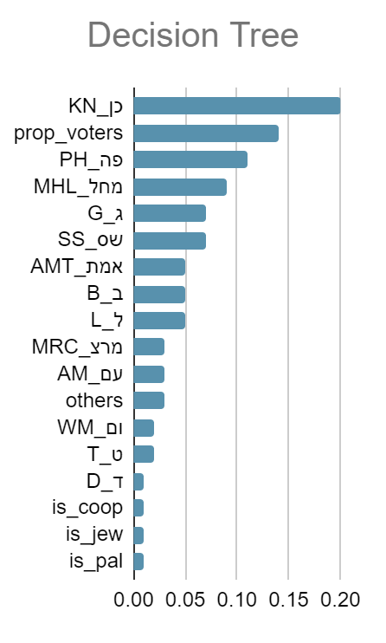
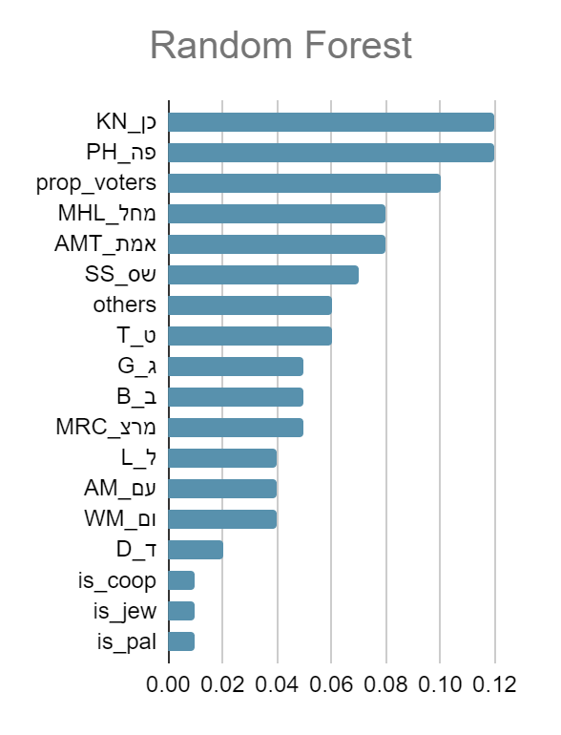
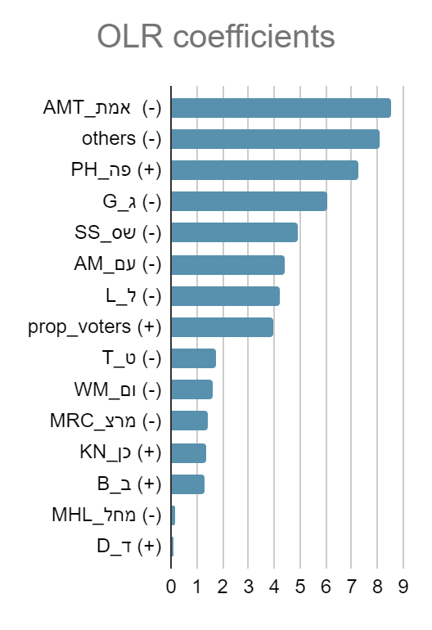
Classification results
Feature importance

